Slide 1
OLAP schema design – deep dive

Slide 2
Facts
Dimensions
Date dimension
Surrogate keys
Hierarchies
Fact table granularity

Slide 3
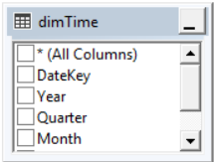
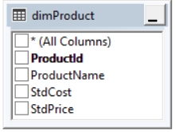
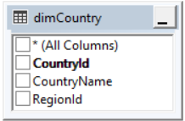
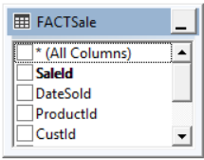
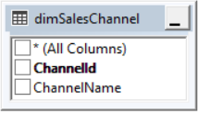
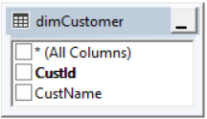

OLAP
schema recap
Notes:
This slide deck will discuss design considerations of OLAP star schema in more detail.

Slide 4
Fact tables contain:
Business facts (or measures).
Foreign keys which point to the primary keys in the dimension tables.
Dimension tables contain:
Descriptive attributes.
Typically textual fields (or discrete numbers that behave like text).
Facts and Dimensions

Slide 5
Fact tables can store different types of measures.
Additive - Measures which can be added to all dimensions (e.g. sale value).
Non-additive - Measures which cannot be added to all dimensions (e.g. percentages).
Semi-additive – Measures which can be added to only some dimensions but not others. Examples:
Bank balance from yesterday cannot be added to today’s bank balance.
Stock levels.
Non-additive and semi-additive facts need to be handled in the presentation layer of the data warehouse.
Where possible, store the fully additive components of these measures in the fact table and calculate the final non/semi-additive component in the presentation layer.
Types of Facts (Measures)

Slide 6
Types of Facts (Measures)
In our superstore data sample we have:
Sales
Quantity
Discount
Profit
Which are additive?
Which are non-additive?

Slide 7
Types of Facts (Measures)
In our superstore data sample we have:
Sales
Quantity
Discount
Profit
Sales, quantity and profit are additive measures.
Discount is non-additive (it’s a %).

Slide 8
Simple Customer dimension allowing selection by customer name, keyed to the fact table by CustId.
Dimension Tables
Common date dimension with multiple levels of grouping, keyed by DateKey to the Fact table.
StdCost & StdPrice not required for dimension operation but may be added as extra information.

Slide 9
Date Dimension
Enables the user to analyse and summarise data in sectors of time.
Financial year, quarter, month or week etc.
Date dimension table provides a reusable date lookup to help ease the creation of date based reports.
Date dimensions are usually hierarchical.
Year > quarter > month > week > day

Slide 10
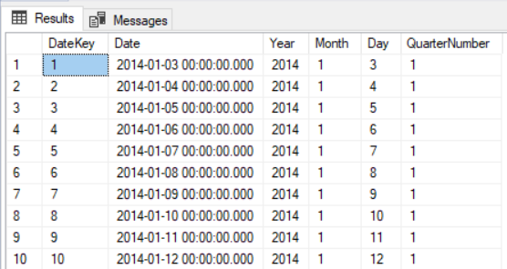
Date Dimension
There are several ways to create a date dimension. You can use an SQL script or using DAX in Power BI.

Slide 11
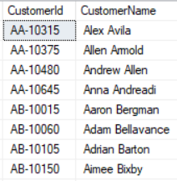
Surrogate Keys
Create Customer Dimension
We can select distinct CustomerIds
This would work perfectly well using CustomerId as the key to the fact table, but adding a SURROGATE KEY protects the data from inadvertent duplication of Customer Id.
Notes:
In some companies, a few of the customers are no longer listed with the companies. They could have left their respective companies many years ago. It is possible that the customer numbers of such discontinued customers are reassigned to new customers. Now, let us say we had used the operational system customer key as the primary key for the customer dimension table. We will have a problem because the same customer number could relate to the data for the newer customer and also to the data of the retired customer. The data of the retired customer may still be used for aggregations and comparisons by city and state.
Do not use production system keys as primary keys for dimension tables.
What then should we use as primary keys for dimension tables? The answer is to use surrogate keys. The surrogate keys are simply system-generated sequence numbers. They do not have any built-in meanings. Of course, the surrogate keys will be mapped to the production system keys. Nevertheless, they are different. The general practice is to keep the operational system keys as additional attributes in the dimension tables.

Slide 12
Surrogate keys are substitute keys that are created in the data warehouse to act as a primary key on behalf of the entity.
They are typically just sequential numbers so there is no inherent meaning in the key value (unlike source system keys).
Using surrogate keys give the data warehouse platform full control of identifying uniqueness in the dimension tables.
Surrogate Keys

Slide 13
Surrogate Keys
But what about the source data primary keys like Customer ID?
Customer ids (and other entity unique columns) are natural keys (or business keys).
Natural keys are keys that exist within the business applications already (usually OLTP database keys).
Sometimes text based and not ideal for indexing.
They cannot be guaranteed to be unique across systems and therefore duplicates may occur.
Surrogate keys are substitute keys generated in the data warehouse which can be set up as unique from the start.
Can be composite keys.

Slide 14
Surrogate Keys
Consider these examples of business (or natural) keys:
Employee number
Account number
National insurance number
Passport number
Can they be guaranteed to…
Be unique?
Remain unchanged?
Notes:
Employee number
Account number
Both of these can be unique within a given organisation, but may be duplicated or need to change
Multiple data sources with conflicting data
Legacy format being modernised
Passport number
Unique in any given country but not elsewhere
Some contain letters as well as numbers
National insurance number
Not likely to change – but it can happen
Text based, letters and numbers

Slide 15
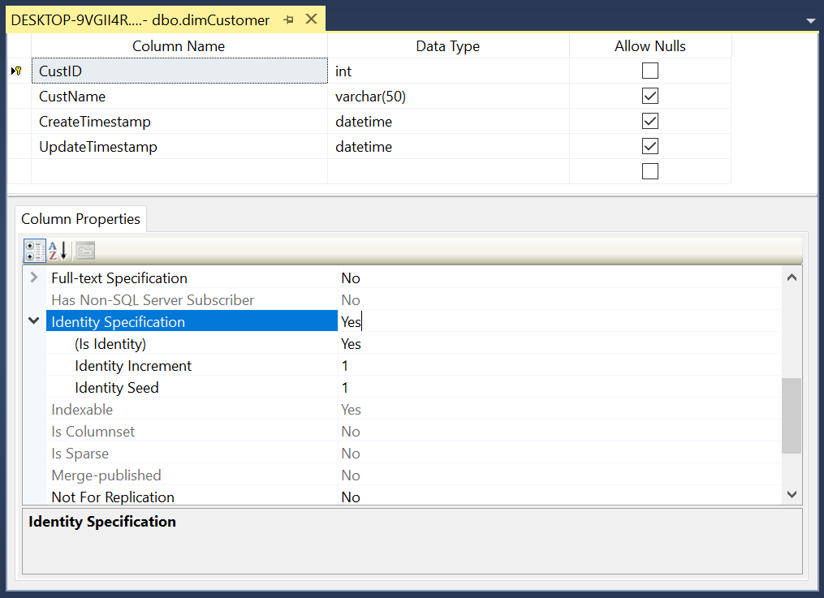
Creating Surrogate Keys
Automatically generated surrogate key
SQL Server has identity columns – other databases have different ways of achieving the same outcome.

Slide 16
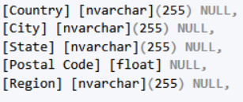
Hierarchies
What about the geographical dimensions?
Five separate dimensions – few rows in each table but too many joins?
One dimension with all columns – only one join but more rows
A mix of columns over multiple tables – best of both? But which columns and what tables?

Slide 17
Hierarchies
No easy answer to this – each case must be decided on merit, however…
The only country is United States so is this necessary? Omitting it could cause issues in the future unless it is added with another column.
Is the postcode relevant? Maybe, maybe not but it only adds a few rows.
Some designers resist snowflake as a single dimension is easier to query. There is a cost to the query in the join between the two tables.

Slide 18
Fact Table Granularity
“The grain of a fact table is the business definition of the measurement event that creates a fact record.”
- Kimball
Consider granularity to be the lowest level of transactional detail that the business currently captures.
A fact record is an event which is characterised by its dimensions.
A unique fact record should be a combination of its foreign keys.
This is how the primary key for the fact table should be defined.

Slide 19
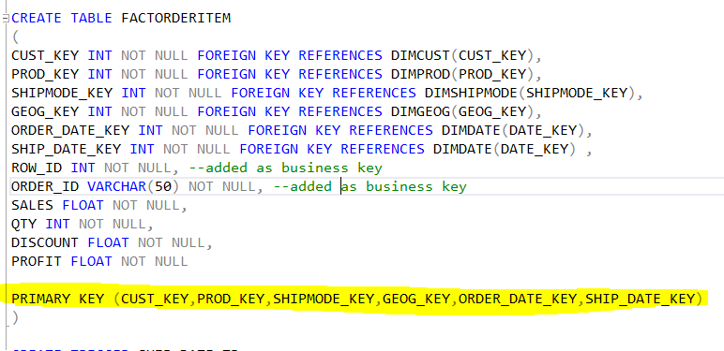
Creating a Fact table
The yellow highlight shows how a composite primary key of all the foreign keys can be declared for the fact table.
In SSMS:
Right click on the table you wish to create the composite key on and select ‘Design’.
Highlight the columns you wish to form as a composite key.
Right click over those columns and ‘Set Primary Key’.

Slide 20
Surrogate Keys… again
Every dimension table should have a surrogate key to uniquely identify each record.
From a logical design perspective the fact table doesn’t need a surrogate key as uniqueness should be derived from the combination of each of the dimension foreign keys.
But quality of data often reveals duplicate rows at the transaction level for the same combination of dimension values.
Implementing a surrogate key on the fact table as part of physical design can guard against this issue.

Slide 21
Further Reading
The Data Warehouse Toolkit
Ralph Kimball
www.kimballgroup.com
Building The Data Warehouse
Bill Inmon
Data Architecture/ Data Lake Architecture
Bill Inmon

